Slide 1
Types of forces

Slide 2
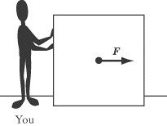
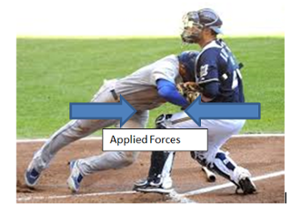
Applied force
An applied force is a force that is applied to an object by a person or another object

Slide 3

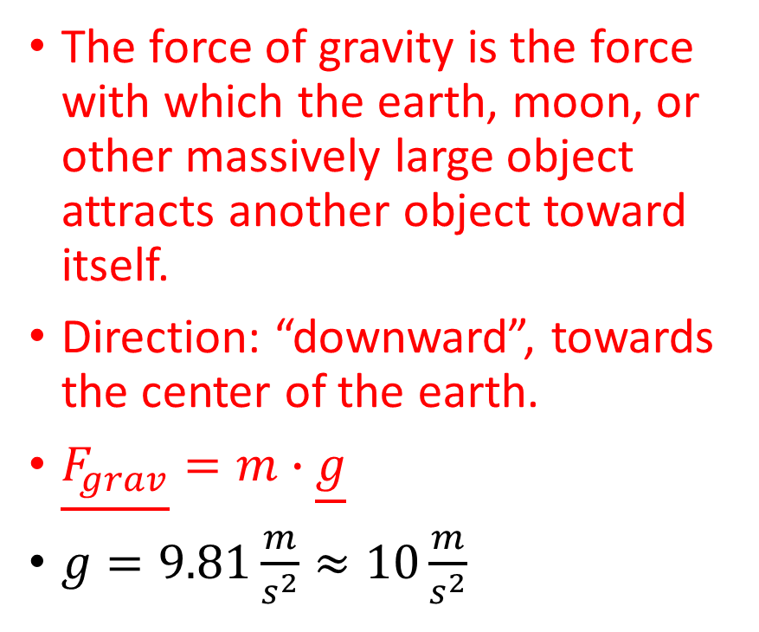
Gravity force - gravitációs erő
The force of gravity is the force with which the earth, moon, or other massively large object attracts another object toward itself.
Direction: “downward”, towards the center of the earth.
$\underline{F_{grav}}=m∙\underline{g}$
$g=9.81\frac{m}{s^{2}}≈10\frac{m}{s^{2}}$
$$\underline{F_{grav}}=m∙\underline{g}$$

Slide 4
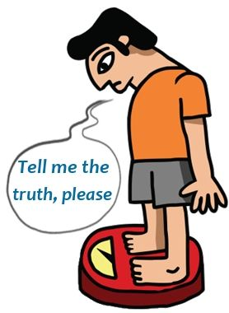
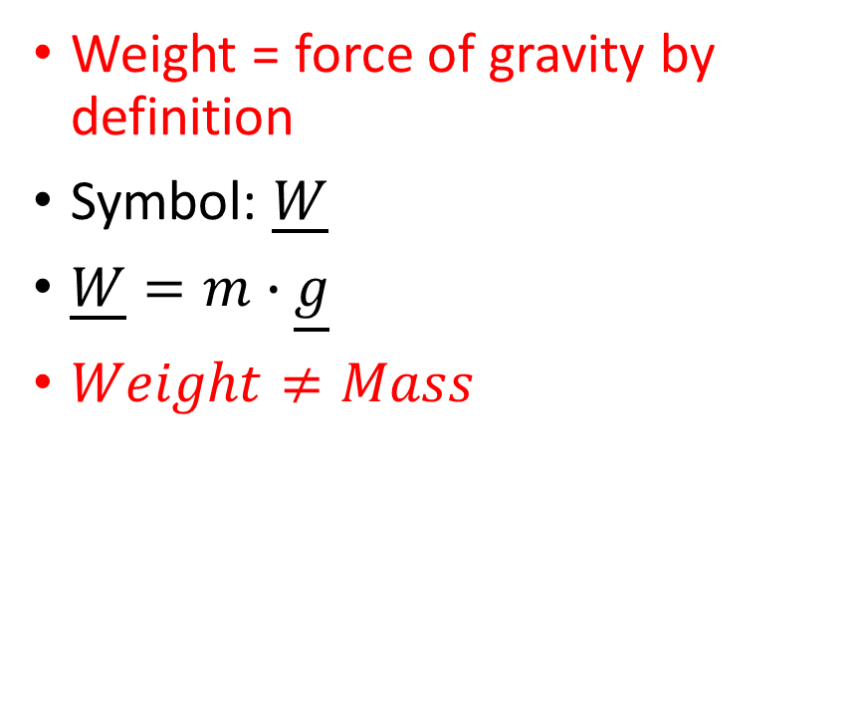
Weight
Weight = force of gravity by definition
Symbol: $\underline{W}$
$\underline{W}=m∙\underline{g}$
$Weight≠Mass$

Slide 5
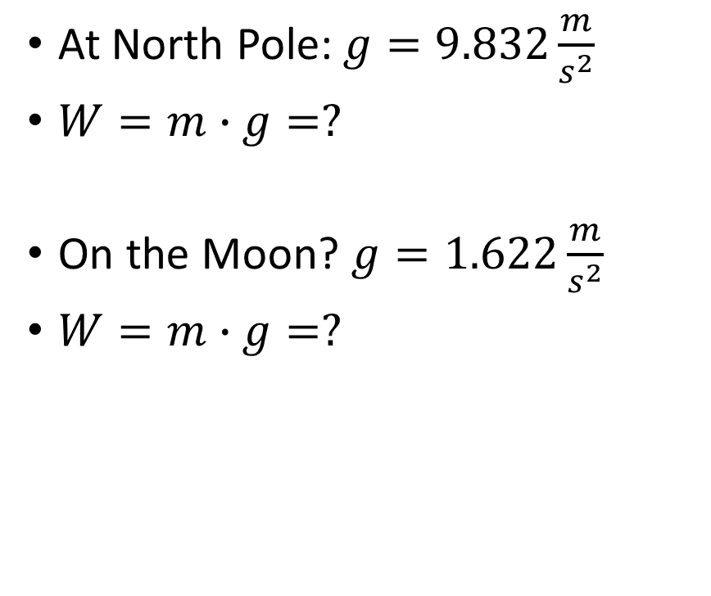
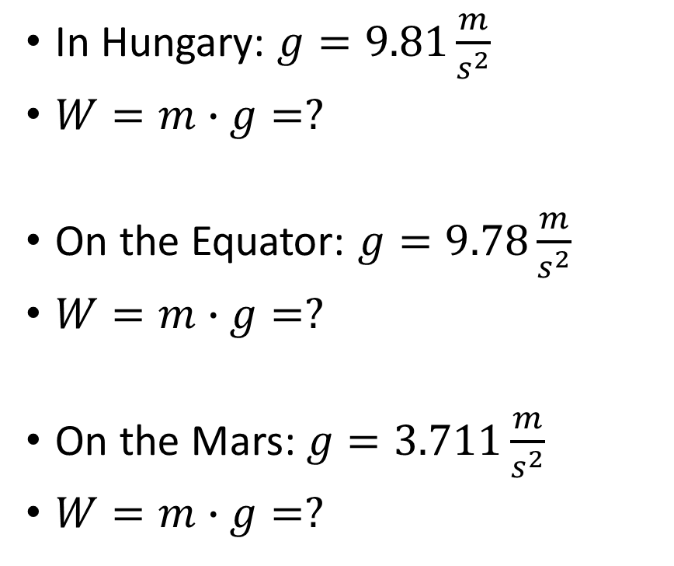
Calculate your weight!
In Hungary: $g=9.81\frac{m}{s^{2}}$
$W=m∙g=?$
On the Equator: $g=9.78\frac{m}{s^{2}}$
$W=m∙g=?$
On the Mars: $g=3.711\frac{m}{s^{2}}$
$W=m∙g=?$
At North Pole: $g=9.832\frac{m}{s^{2}}$
$W=m∙g=?$
On the Moon? $g=1.622\frac{m}{s^{2}}$
$W=m∙g=?$

Slide 6
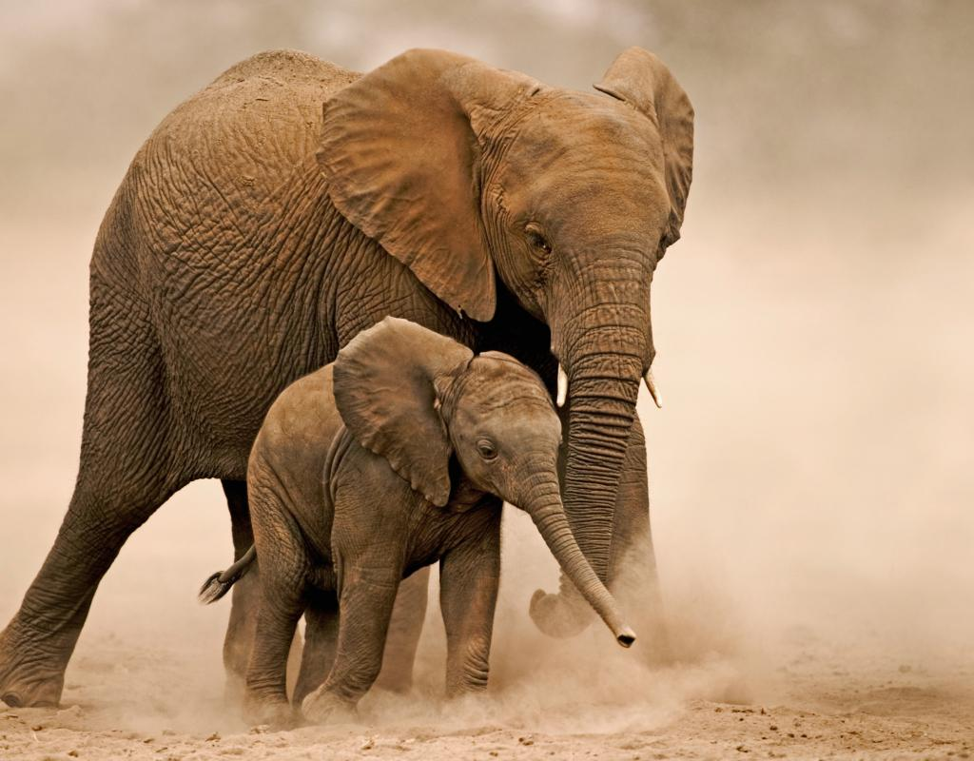
Calculate mass!
An African elephant’s weight is 58800 N. Calculate its mass!

Slide 7
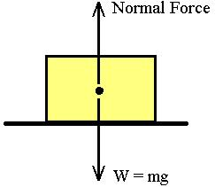
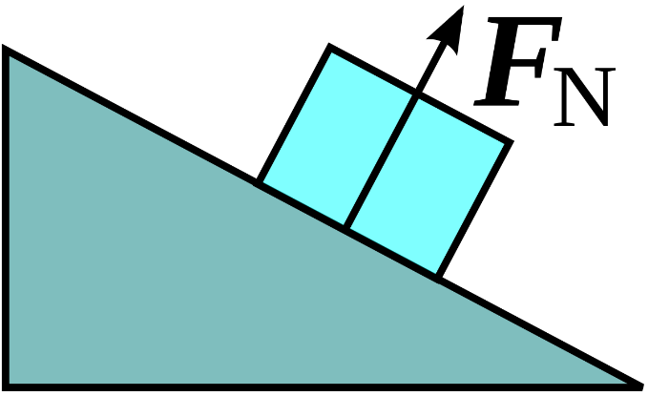
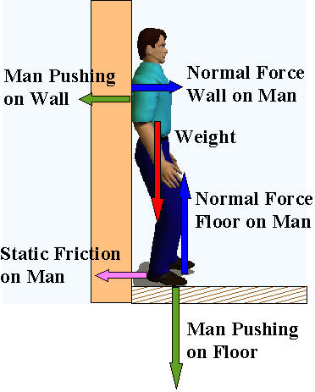
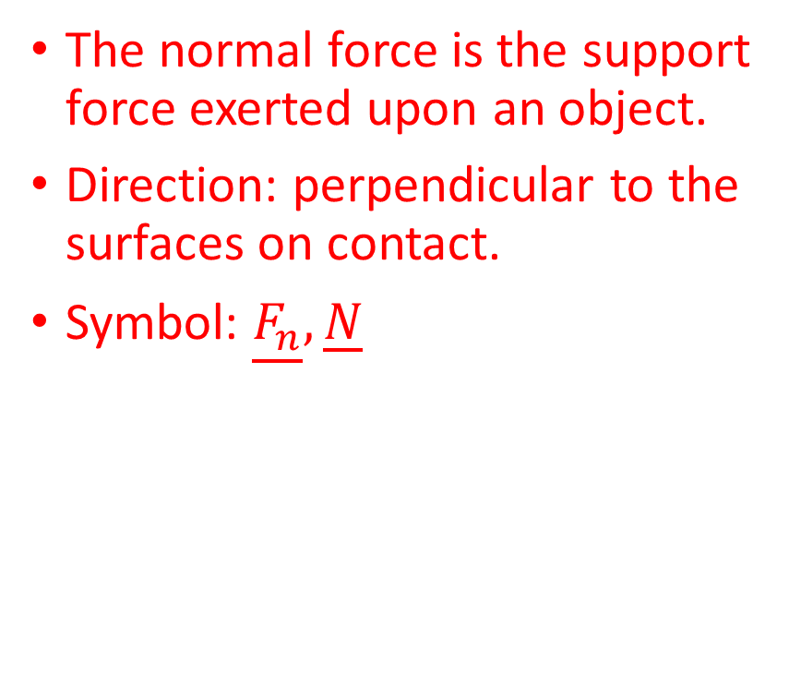
Normal force-Nyomóerő
The normal force is the support force exerted upon an object.
Direction: perpendicular to the surfaces on contact.
Symbol: $\underline{F_{n}}, \underline{N}$

Slide 8
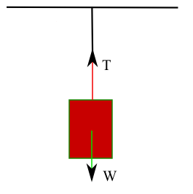
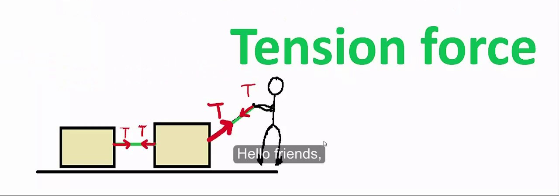
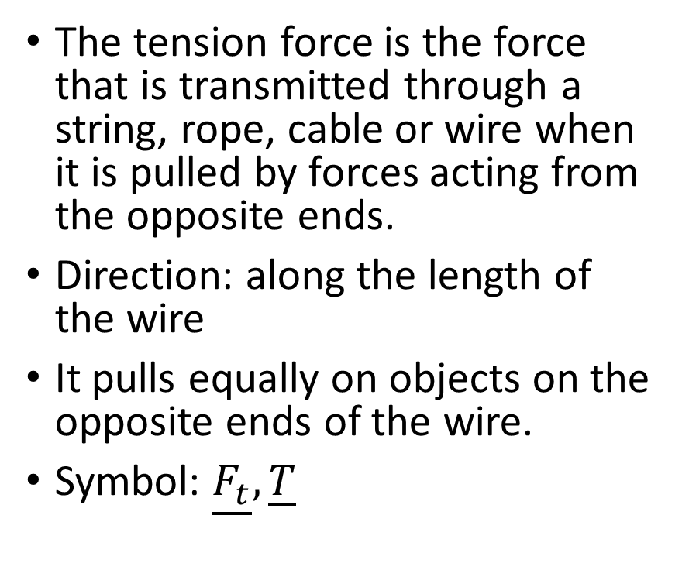
Tension force-Kötélerő
The tension force is the force that is transmitted through a string, rope, cable or wire when it is pulled by forces acting from the opposite ends.
Direction: along the length of the wire
It pulls equally on objects on the opposite ends of the wire.
Symbol: $\underline{F_{t}}, \underline{T}$

Slide 9
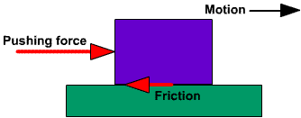
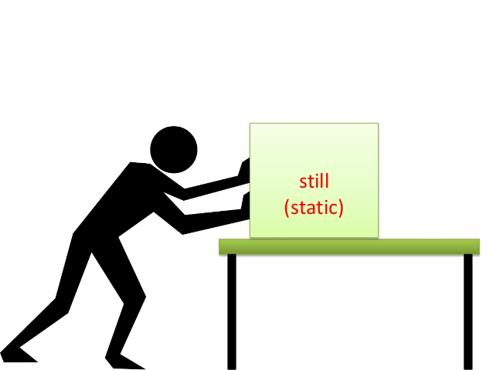
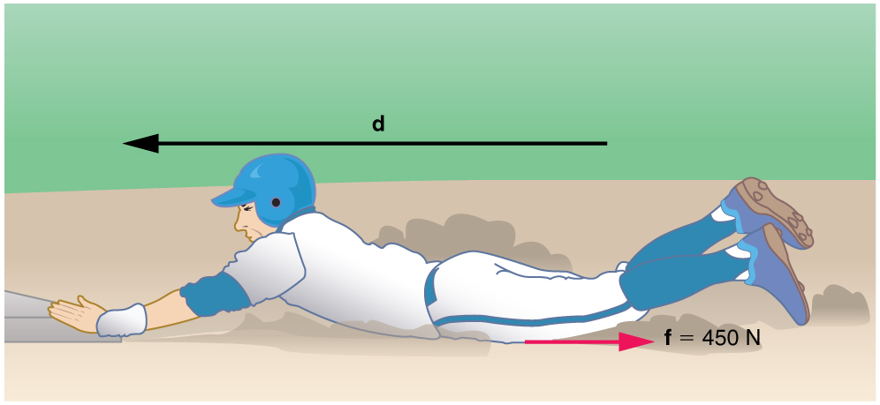
Friction force-Súrlódási erő
The friction force is the force exerted by a surface as an object moves across it or makes an effort to move across it.
Two types:
Sliding friction force
Direction: opposite to the direction of the motion
Static friction force

Slide 10
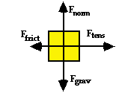
Problem 1.
Unfortunately for Vanessa, the wheels on her suitcase are not working. She pulls on the strap in an effort to budge it from rest and drag it to the curbside check-in desk. The free body diagram at the right depicts the forces acting upon the suitcase. Use force values to determine the net force, the mass and the acceleration of the suitcase. The values of the individual forces are:
F_{grav} = F_{norm} = 207 N F_{tens} = 182 N F_{frict} = 166 N.

Slide 11
Problem 2.
It's Friday night and Skyler has been assigned the noble task of baby-sitting Casey, his 2-year old brother. He puts a crash helmet on Casey, places him in the red wagon and takes him on a stroll through the neighborhood. As Skyler starts across the street, he exerts a 52 N forward force on the wagon. There is a 24 N friction force and the wagon and Casey have a combined weight of 304 N. Construct a free body diagram depicting the types of forces acting upon the wagon. Then determine the net force, mass and acceleration of the wagon.

Slide 12
Problem 3.
Mira and Tariq are lab partners for the Pulley and Bricks Lab. They have determined that the 2.15-kg brick is experiencing a forward tension force of 9.54 N and a friction force of 8.69 N as it is accelerated across the table top. Construct a free body diagram depicting the types of forces acting upon the brick. Then determine the net force and acceleration of the brick.

Slide 13
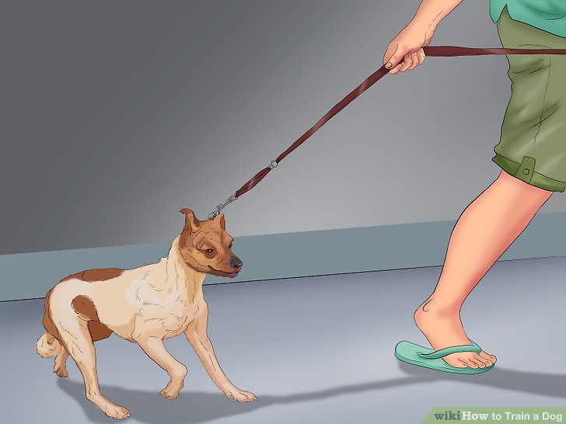
Problem 4.
Hector is walking his dog (Fido) around the neighborhood. Upon arriving at Fidella's house (a friend of Fido's), Fido turns part mule and refuses to continue on the walk. Hector yanks on the chain with a 67.0 N force at an angle of 30.0° above the horizontal. Determine the horizontal and vertical components of the tension force.

Slide 14
Problem 5.
At one moment during a walk around the block, there are four forces exerted upon Fido - a 10.0 kg dog. The forces are:
F_{app} = 67.0 N at 30.0° above the horizontal (rightward and upward) F_{norm} = 64.5 N, up F_{frict} = 27.6 N, left F_{grav} = 98 N, down
Resolve the applied force (F_{app}) into horizontal and vertical components, then add the forces up as vectors to determine the net force.

Slide 15
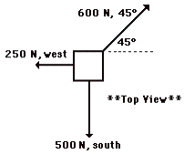
Problem 6
A pack of three Artic wolves are fighting over the carcass of a dead polar bear. A top view of the magnitude and direction of the three forces is shown in the diagram to the right.
a. Determine the resultant or net force acting upon the carcass. b. Determine the acceleration of the 750-kg polar bear carcass.

Slide 16
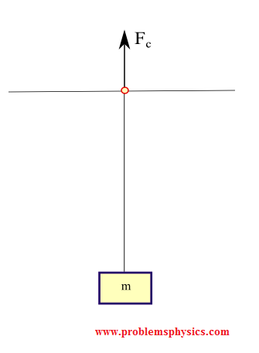
Problem 7.
A block of mass 5 Kg is suspended by a string to a ceiling and is at rest. Find the force F_{c} exerted by the ceiling on the string. Assume the mass of the string to be negligible.

Slide 17
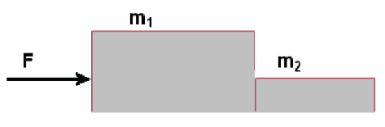
Problem 9.
We put two blocks next to each other on a horizontal frictionless surface. The mass of the blocks are 3 kg and 5 kg. We push the 5 kg block with a force of 40 N.
Find the acceleration of the system.
Calculate the normal force between the cubes.

Slide 18
Problem 8.
Two objects whose masses are 5.0 kg and 10.0 kg are suspended by strings as shown. Find the tension in each string.

Slide 19
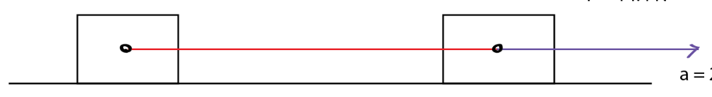
Problem 10
There are two blocks on a horizontal frictionless surface with a mass of 2 kg and 3 kg. They are linked to each other by a string. We pull them with a force of 10 N.
Find the acceleration of the system.
Find the tension force on the string.

Slide 20
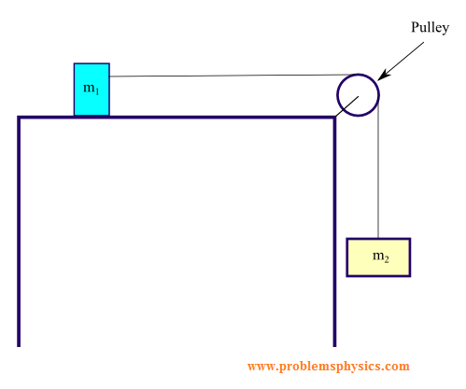
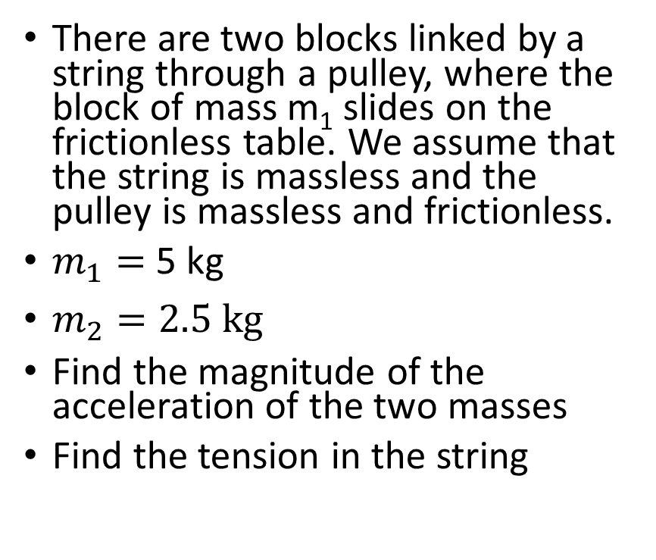
Problem 11.
There are two blocks linked by a string through a pulley, where the block of mass m₁ slides on the frictionless table. We assume that the string is massless and the pulley is massless and frictionless.
$m_{1}=$ 5 kg
$m_{2}=2.5 kg$
Find the magnitude of the acceleration of the two masses
Find the tension in the string

